Slide 1
Node + Mongo
By Diwakar Adhikari & Madhhav Wason

Slide 2
About Node
Node.js comes with many benefits, making it suitable for building enterprise and business to customer applications. JavaScript is one of the most preferred and commonly used backend technology.
Node.js is a JavaScript framework and a runtime environment that runs JavaScript code outside the web browser. JavaScript is a programming language that drastically changed web development and has been in use by IT specialists worldwide since 1995.
Node.js works well with a real-time handling large amount of information. Node.js enables the collection and visualization of data to be presented as dashboards.

Slide 3
About MongoDB
MongoDB is a document database used to build highly available and scalable internet applications. MongoDB is a source-available cross-platform document-oriented database program.
Classified as a NoSQL database program, MongoDB uses JSON-like documents with optional schemas. With its flexible schema approach, it’s popular with development teams using agile methodologies.
You can use MongoDB Atlas which is a fully-managed cloud database that handles all the complexity of deploying, managing, and healing your deployments on the cloud service provider of your choice (AWS , Azure, and GCP). It is used to deploy, run, and scale MongoDB in the cloud.
https://www.mongodb.com/atlas

Slide 4
Express
Express is a minimal and flexible Node.js web application framework that provides a robust set of features for web and mobile applications.

Slide 5
Nodemon
Nodemon is a utility that will monitor for any changes in your source and automatically restart your server. Perfect for development. Install it using npm.
npm install -g nodemon

Slide 6
Body Parser
To handle HTTP POST requests in Express.js, you need to install the middleware module called body-parser. body-parser extracts the entire body portion of an incoming request stream and exposes it on req.body.
The middleware was a part of Express.js earlier but now you have to install it separately.
This body-parser module parses the JSON, buffer, string and URL encoded data submitted using HTTP POST request. Install body-parser using NPM as shown below.
npm install body-parser --save

Slide 7
About the Application
Mongoose -> Mongoose is a JavaScript object-oriented programming library that creates a connection between MongoDB and the Express web application framework.

Slide 8
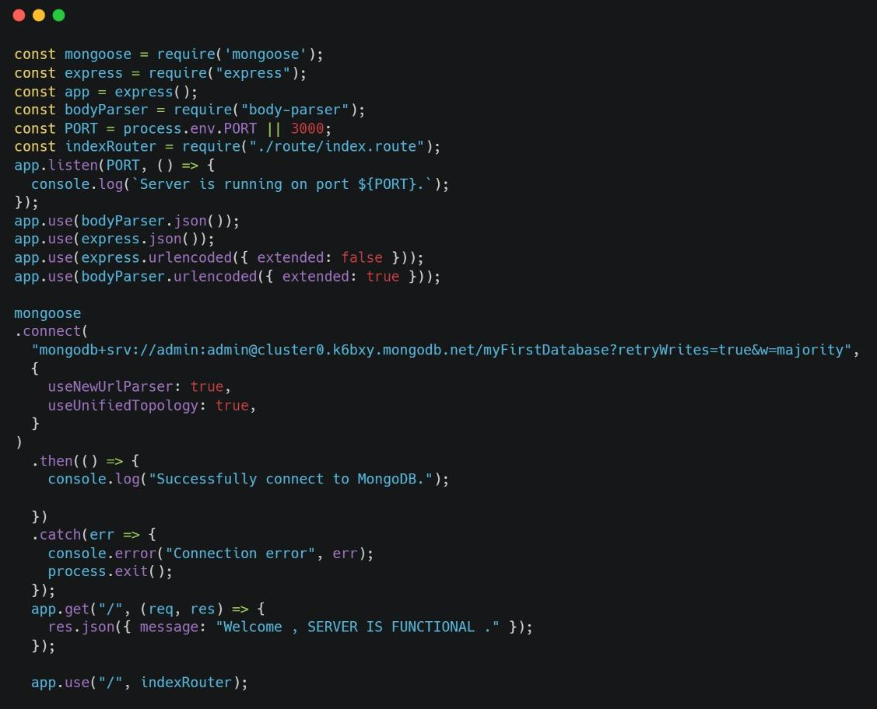
index.js

Slide 9
index.js

Slide 10
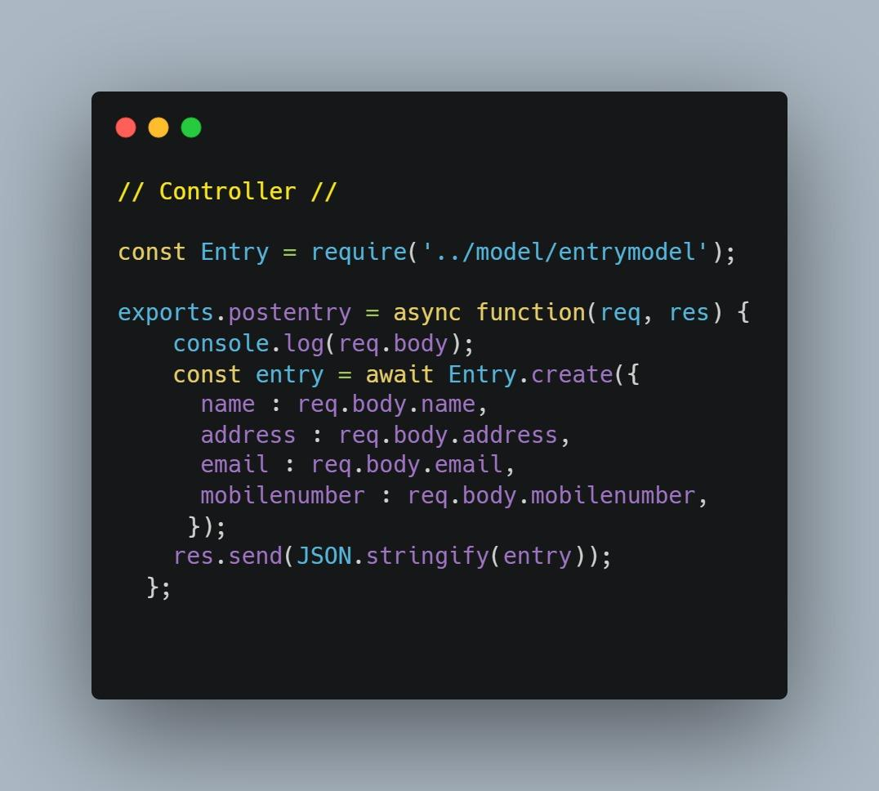
Controller

Slide 11
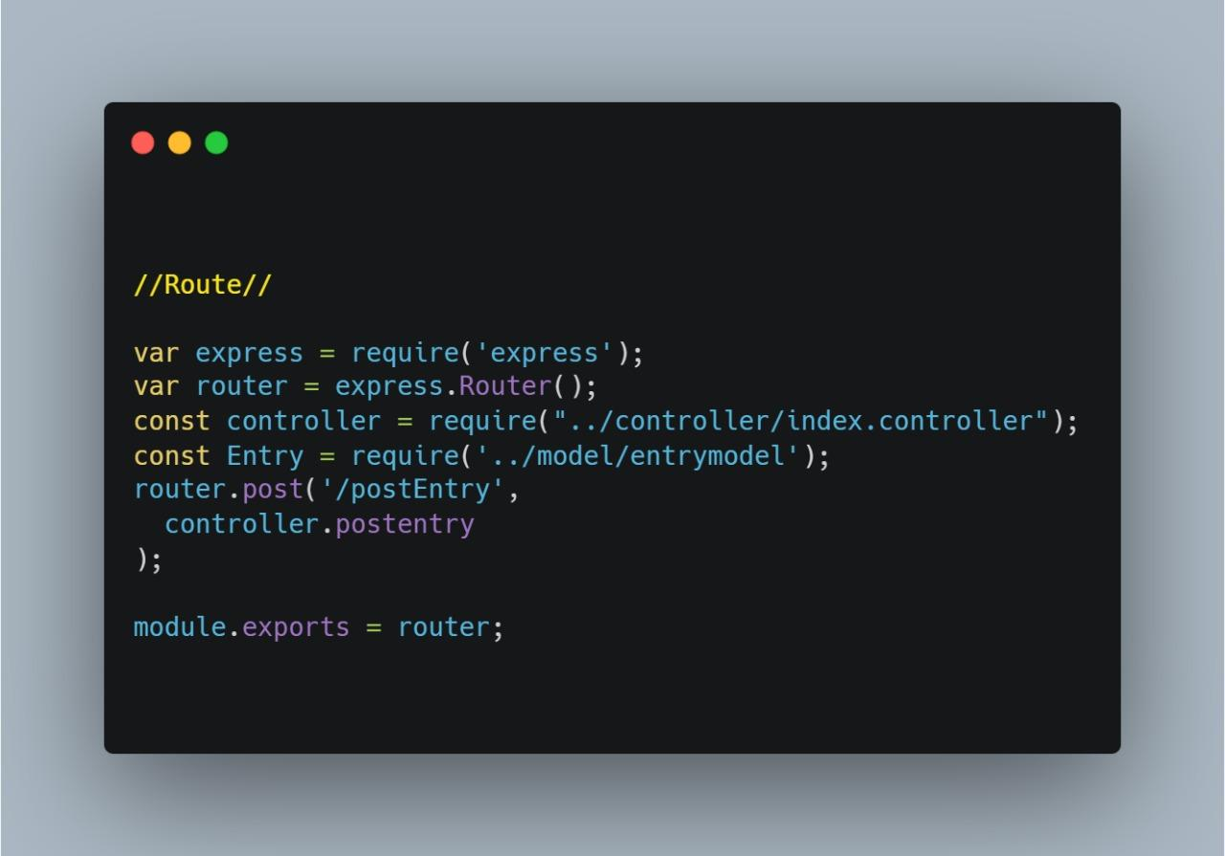
Route

Slide 12
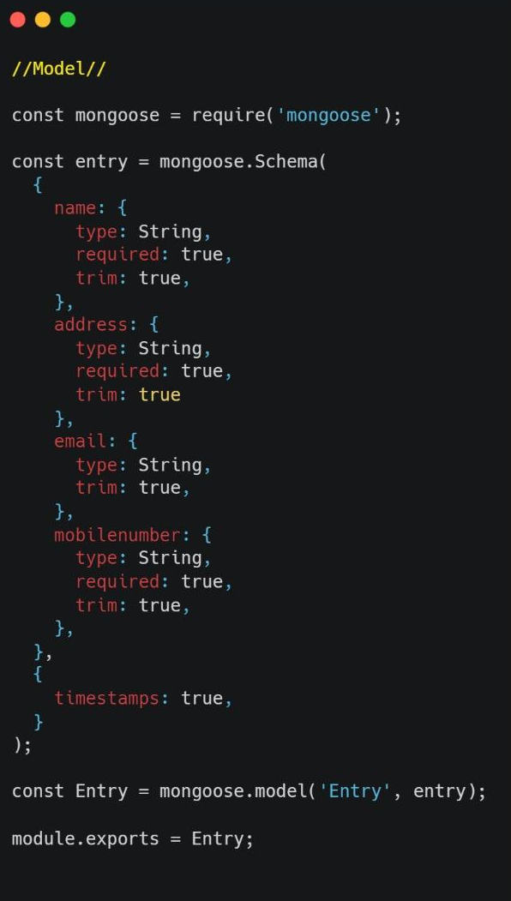
Model

Slide 13
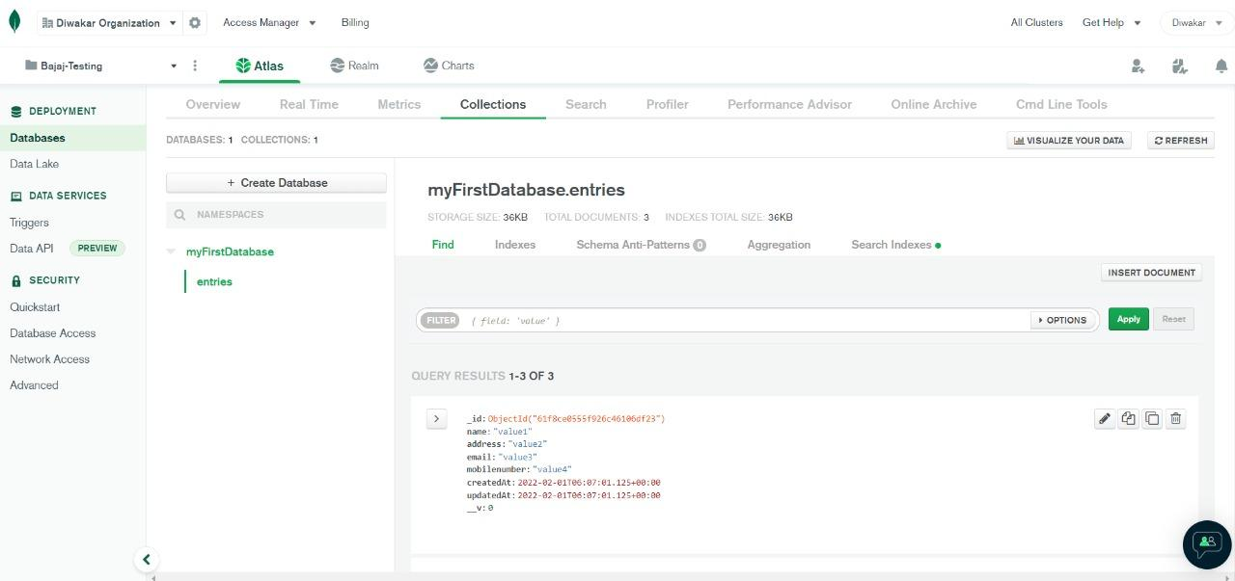
Mongo Atlas

Slide 14
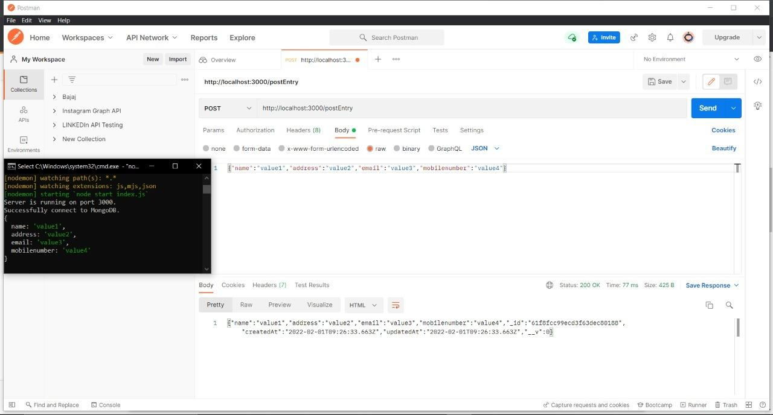
Postman

